Slide 1
Virtual Machines: Enabling Modern Operating Systems
Mohammad Abdullah 356
Md Abu Bakkar Siddiq 328
Sijan MD Masudur Rahman 317
14-05-2025
Operating System
China west normal university

Slide 2
Main Topic
Introduction VMs
Memory Systems in Virtual Machines
Security in Virtual Machines
VMs vs Containers
LLM AGENT OPERATING SYSTEM

Slide 3
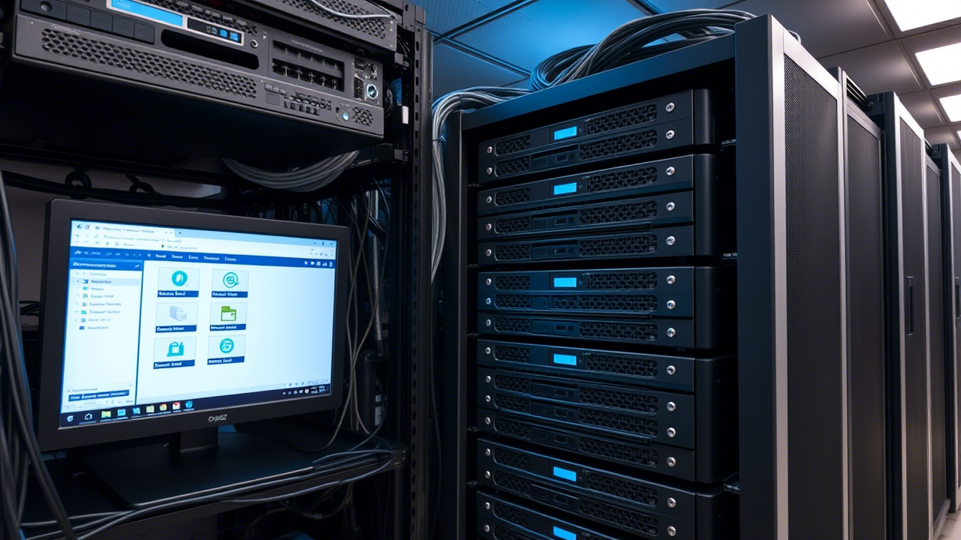
What is a Virtual Machine?

Slide 4
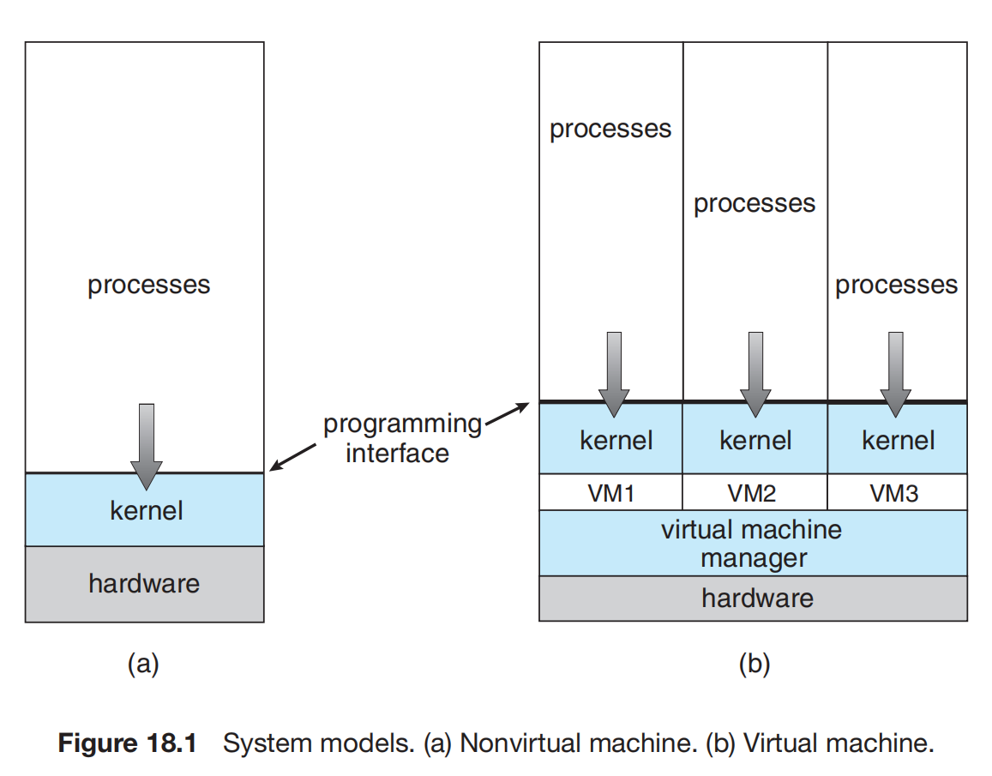
So, What is VM actually & What have insides
A Virtual Machine (VM) is an emulation of a computer system that operates in an isolated software environment, sharing physical hardware resources through virtualization (Smith & Nair, 2005).
As simple I say a computer inside a computer
Core components of VM:
Abstraction
Hypervisor (VM monitor)
Type 1 (Bare-metal)
Type 2 (Hosted)
Guest OS vs Host OS
Goldberg, R. P. (1974). "Survey of Virtual Machine Research." IEEE Computer, 7(6), 34-45.

Slide 5
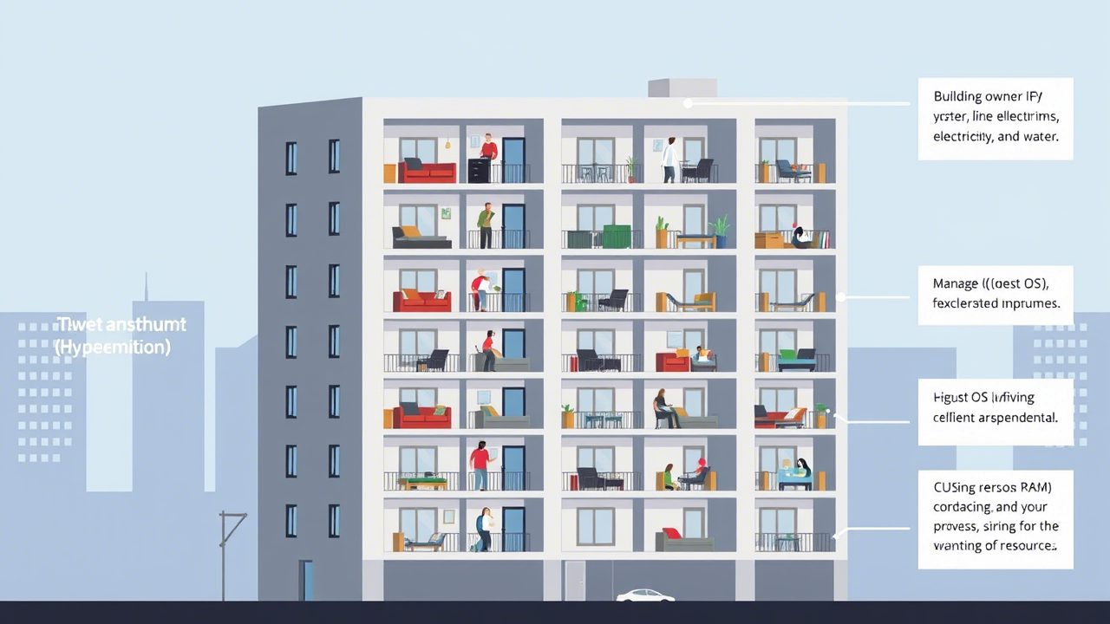
Real-World Analogy: Renting Apartments in a Shared Building
Imagine a large apartment building (the physical computer) divided into multiple apartments (virtual machines).
Building Owner (Hypervisor) – Manages the building, ensuring each apartment gets electricity, water, and space.
Apartments (VMs) – Each tenant (Guest OS) has their own private space, unaware of others.
Shared Infrastructure (Host OS & Hardware) – The building’s foundation (CPU, RAM) is shared, but each apartment operates independently.
Just like tenants don’t need to know how the plumbing or electricity is distributed, VMs run isolated from each other while sharing the same physical hardware.

Slide 6
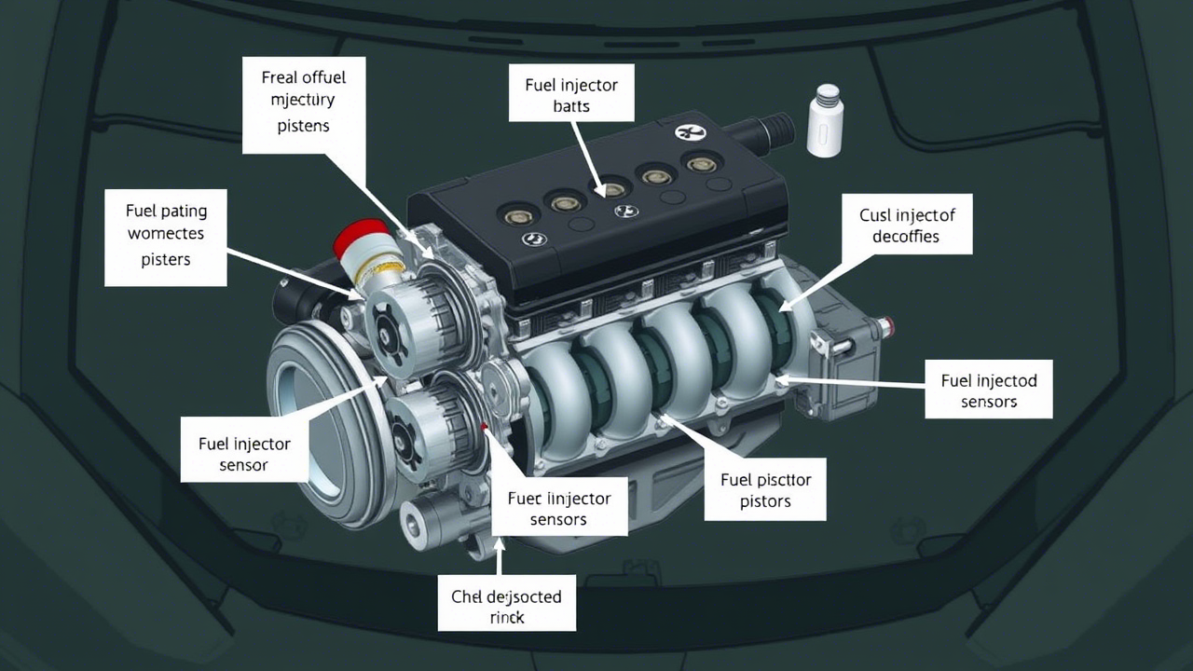

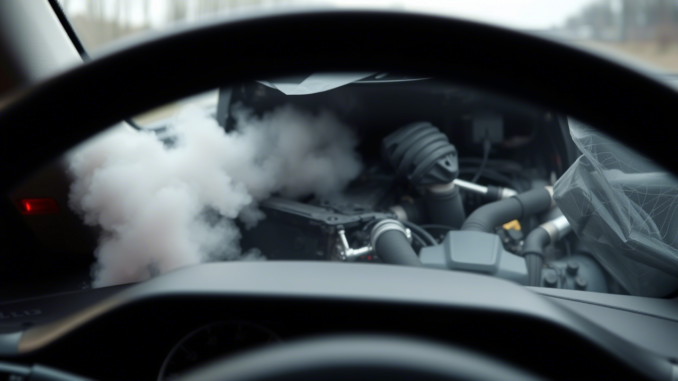
What is Abstraction in VMs
Abstraction in VMs refers to the process of hiding complex hardware details and presenting a simplified, virtualized version of computing resources to guest operating systems (OS) and applications.
For example: A car’s Dashboard
A car engine has hundreds of parts (pistons, fuel injectors, sensors).
Equivalent in VM: Physical servers have CPUs, RAM, disks, NICs.
You interact with just a speedometer, fuel gauge, and buttons—no need to understand the engine.
Equivalent in VMs: The hypervisor gives each VM a simple "dashboard" (vCPU, vRAM, vDisk).
If you crash your car, the engine keeps running.
Equivalent in VMs: A crashing app in a VM won’t crash the host.
AWS EC2 (Your "Rental Car") What You See: A "virtual server" with 4 vCPUs, 16GB RAM. Reality: It’s abstracted from a massive server cluster in AWS’s data center. Just Like: Renting a car without caring about its engine model.

Slide 7
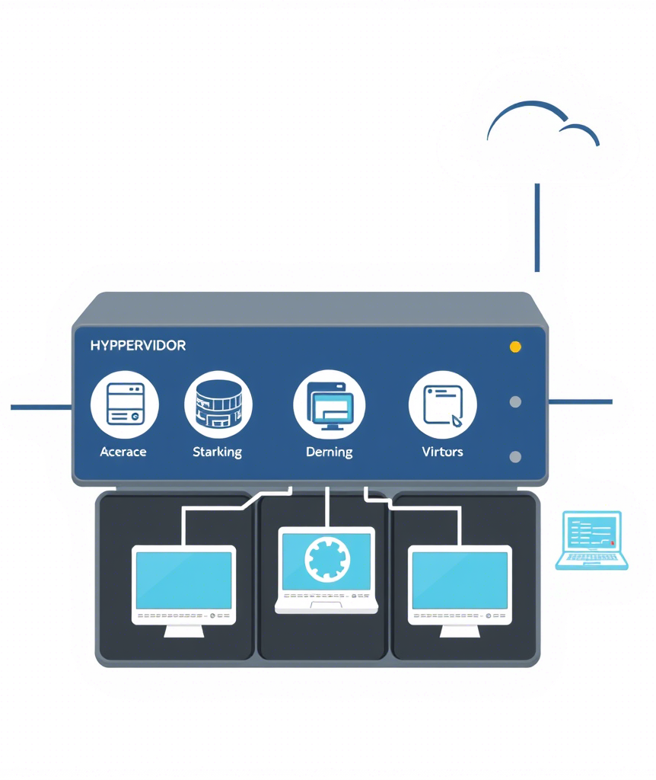
A hypervisor (or Virtual Machine Monitor, VMM) is software/firmware that creates and manages virtual machines (VMs). It acts as a "traffic cop" for hardware resources, letting multiple VMs share a single physical server safely. Types of Hypervisors 1. Type 1 (Bare-metal) Runs directly on hardware. Highest performance & security. (VMware ESXi, Microsoft Hyper-V, Xen) Enterprise servers, cloud computing (AWS, Azure). 2. Type 2 (Hosted) Runs on top of a host OS (Windows/macOS). Easier to set up. (VirtualBox, VMware Workstation, Parallels) Desktop virtualization, testing environments.
Application - Guest OS #1 (Windows)
Application - Guest OS #2 (Linux)
Hypervisor - Managed CPU, RAM, Storage
Hardware - Physical Server, PC

Slide 8
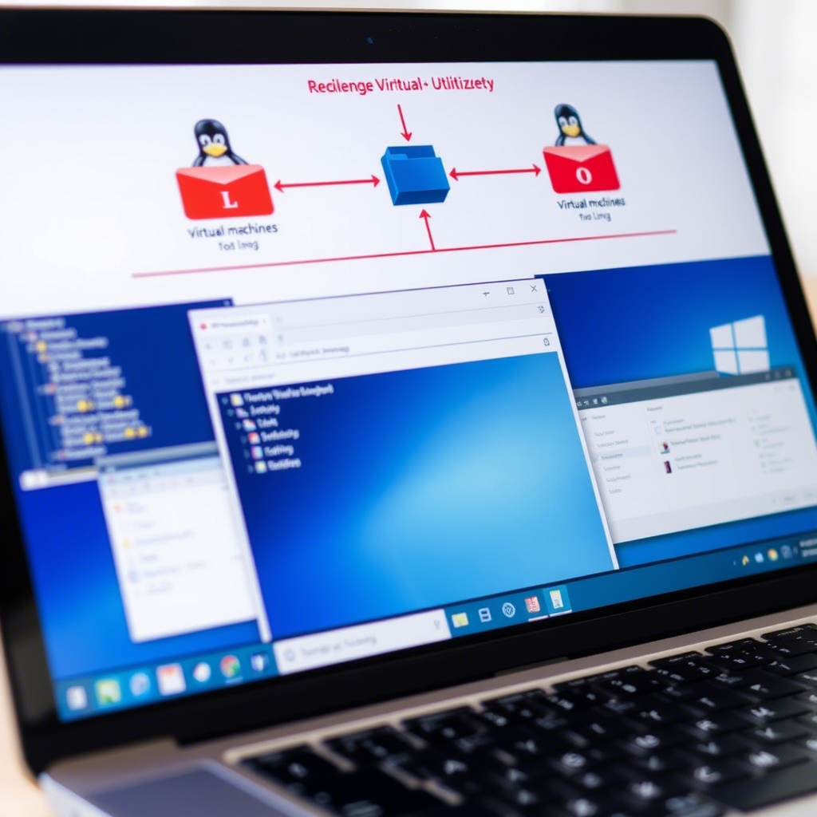
So, Why we use VMs
Run multiple OSes on one machine (Linux on a Windows PC).
Test software safely without affecting the main system.(specially for Hacking)
Save costs by consolidating servers (cloud computing relies heavily on VMs).

Slide 9
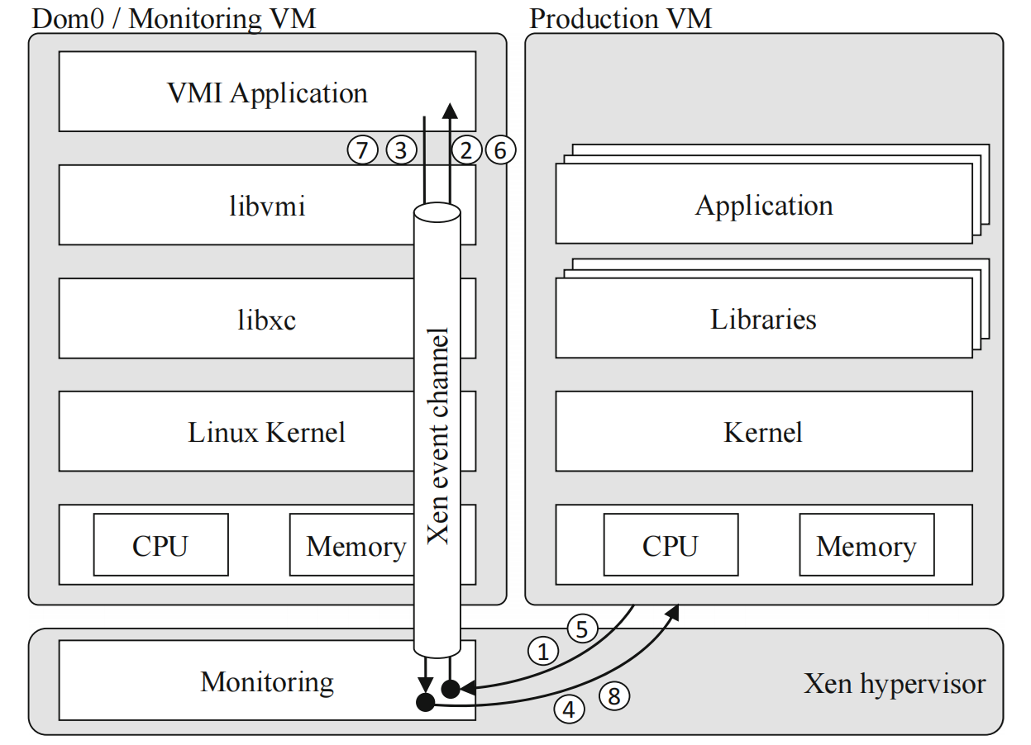
Types of Virtualization
Full Virtualization: Complete emulation of hardware (VMware ESXi).
Paravirtualization: Modified guest OS for efficiency, directly access hardware (Xen with paravirtualized drivers).
OS-Level Virtualization: Containers (Docker) for lightweight isolation.
Smith & Nair (2005): Virtual Machines: Versatile Platforms for Systems and Processes.
Barham et al. (2003): Xen and the Art of Virtualization (ACM SOSP).
Soltesz et al. (2007): Container-based Operating System Virtualization (USENIX).
Fig. 1. VMI architecture using Xen and Libvmi. The arrows show the control flow of
VM Exit/Entry-based context switches when a sensitive instruction in the production
VM triggers a VMI event. The numbered items illustrate that synchronous tracing with
breakpoints requires two iterations, the first to intercept the breakpoint and single
step the original instruction, the second to re-insert the breakpoint and resume the
production VM.

Slide 10
Trade-off Summary
Metric | Full Virtualization | Para-virtualization | OS-level (Containers)
Isolation | (Strongest) | (Good) | (Weakest)
Performance | (Slowest) | (Medium) | (Fastest)
Flexibility | (Any OS) | (Modified OS) | (Same OS only)
Need security? Use Full Virtualization (emalware analysis).
Need speed? Use Containers (cloud microservices).
Balance both? Para-virtualization (high-performance clouds like AWS Nitro).

Slide 11
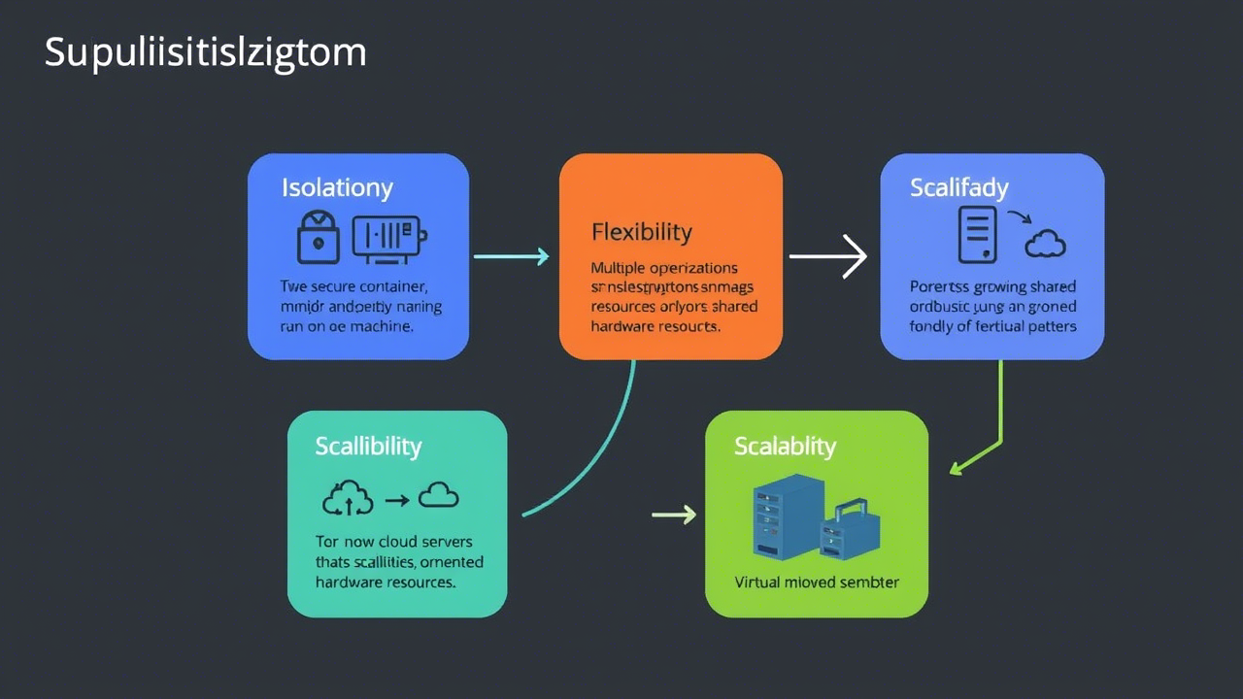
Benefits of Virtual Machines (VMs) & Hypervisor
Isolation
Each VM operates independently, preventing failures or attacks in one VM from affecting others.
Critical for security (malware analysis, multi-tenant clouds).
Flexibility
Run multiple OSes simultaneously (Linux on a Windows PC).
Ideal for software testing, legacy app support, and cross-platform development.
Resource Optimization
Efficiently share CPU, memory, and storage across VMs.
Reduces hardware costs via server consolidation ( cloud data centers).
Scalability & Portability
VMs can be cloned, migrated, or scaled dynamically.
Enables cloud computing (AWS, Azure) and disaster recovery.

Slide 12
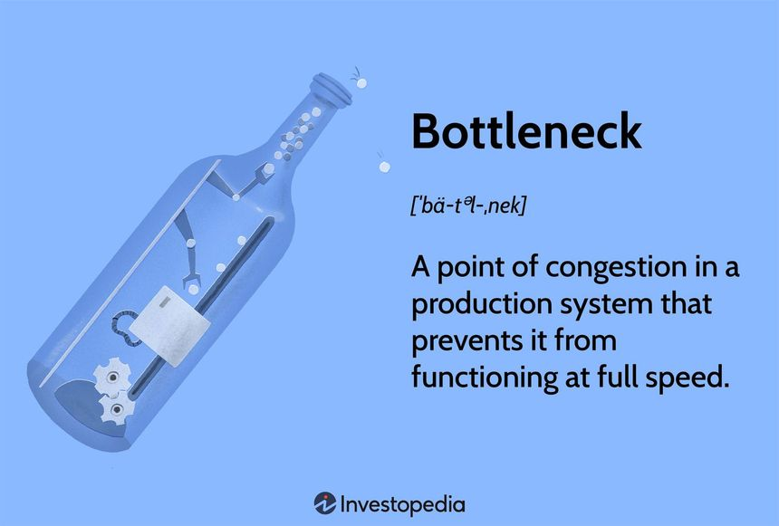
I/O Management (Network & Storage)
Para-virtualized I/O (PV Drivers):
Modified Guest OS drivers communicate directly with the hypervisor (Xen’s netfront/blkfront).
Faster than full emulation.
Requires modified guest OS (Windows needs extra drivers).
Hardware Passthrough:
Bypasses the hypervisor for near-native performance (used in cloud GPUs/NICs).
High cost/ complex setup
Software-Defined Networking (SDN):
Virtual switches (Open vSwitch) manage inter-VM traffic.
Slight latency overhead (~10µs per hop).
I/O bottlenecks are common in high-density VM environments.

Slide 13
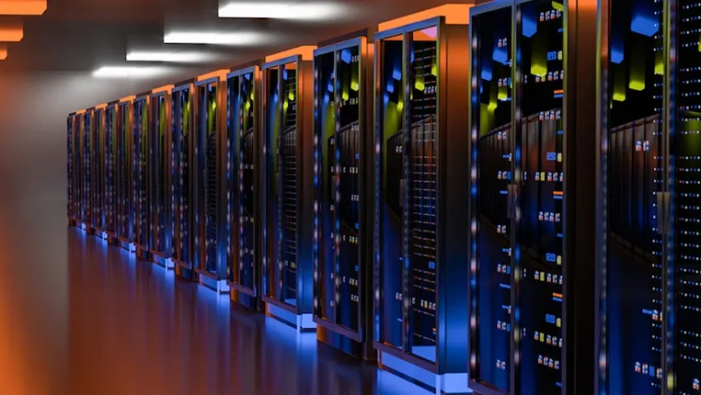
Memory Management In Virtual Machines

Slide 14
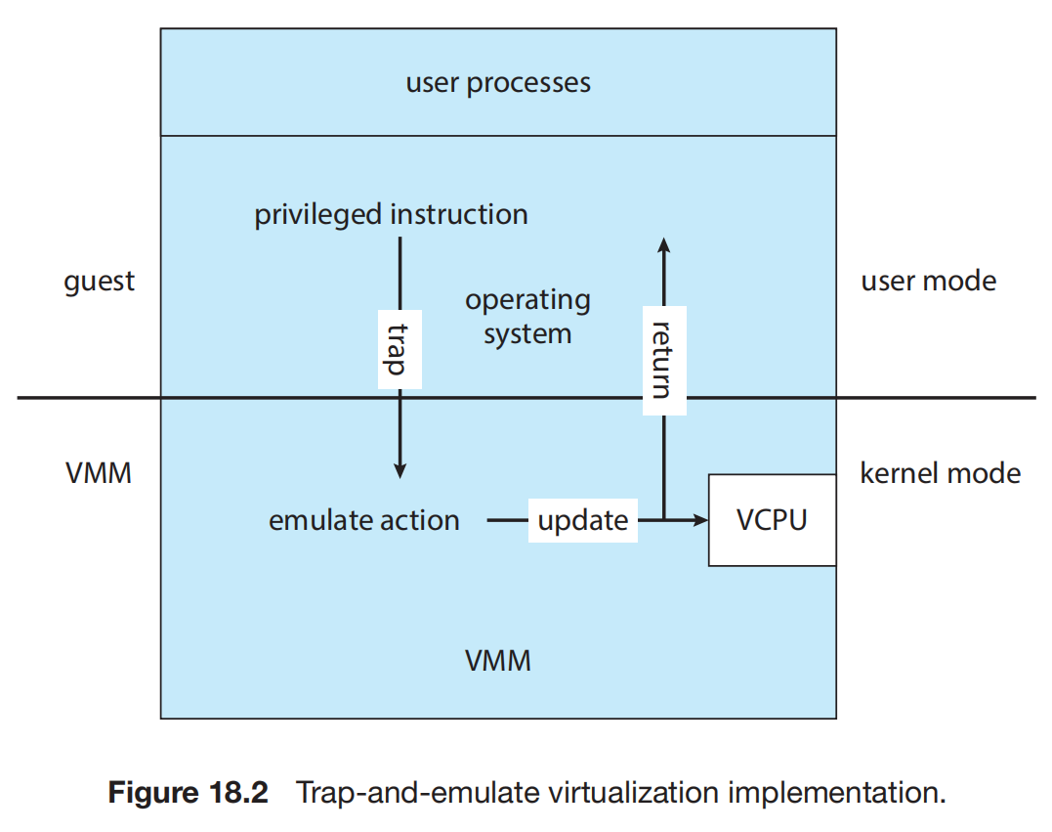
Trap-and-Emulate in Virtual Machines
Trap:
When a VM tries to do something privileged (e.g., access the CPU or disk), the hypervisor intercepts it (like a "pause button").
Example: A guest Linux OS tries to change CPU settings → Hypervisor catches this request.
Emulate:
The hypervisor fakes the result of the operation (like a video game simulating physics).
Example: Instead of real disk access, the hypervisor returns data from a virtual disk file.
Real-World Analogy
Imagine a kid (guest OS) playing with a toy steering wheel (hardware):
The parent (hypervisor) lets the kid "drive" but secretly controls the car.
If the kid tries to honk (privileged action), the parent intercepts and makes a "beep" sound instead.

Slide 15
Paging in Virtual Machines (VMs)
How Paging Works in VMs
Guest OS Perspective:
The VM sees virtual RAM (vRAM), a contiguous memory space (e.g., 8GB).
The guest OS uses its own page tables to map vRAM to "guest-physical" addresses.
Hypervisor Perspective:
The hypervisor translates "guest-physical" addresses to real physical RAM using nested page tables (Intel EPT/AMD RVI).
This ensures VMs cannot access each other’s memory.
Real-World Example
Scenario: A VM runs a program that allocates 4GB vRAM, but only 1GB is actively used.
Paging in Action:
Hypervisor maps only the 1GB to real RAM.
The rest stays on disk until needed (transparent to the VM).
Paging is a memory management technique where the hypervisor (or host OS) divides physical RAM and virtual memory into fixed-size blocks called pages (typically 4KB). It allows:
Isolation: Each VM thinks it has dedicated RAM.
Efficiency: Physical RAM is shared dynamically across VMs.
Swapping: Less-used pages can be moved to disk (swap space) when RAM is full.

Slide 16
Hypervisor Resource Allocation Flowchart
VM Requests CPU
Hypervisor Scheduler
Time Slicing / CPU Pinning
Physical CPU Cores
VM Request Memory
EPT / Shadow Paging
Physical RAM
Manages VM
Physical Mapping

Slide 17
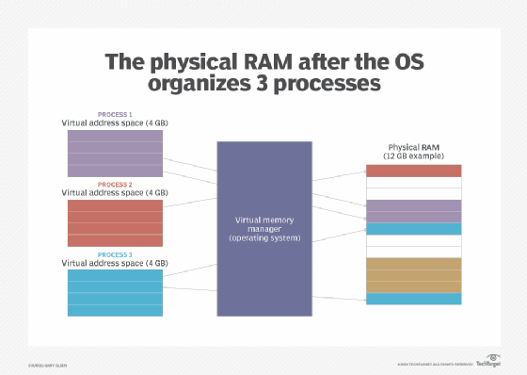
Memory Architecture in Virtual Machines
Memory Partitioning in Virtualization
Physical Host Memory is split between:
Host OS (Windows/Linux running the hypervisor).
Hypervisor (manages VM memory allocation).
Guest VMs (each believes it owns dedicated RAM).
The hypervisor acts like an OS for VMs just as an OS tricks processes into thinking they own all memory, the hypervisor tricks VMs.
Guest VM 1 ← Thinks it has 4GB RAM
(Virtual Memory)
Guest VM 2 ← Thinks it has 8GB RAM
(Virtual Memory)
Hypervisor ← Maps virtual→ physical memory
Physical RAM (32GB) ← Actual hardware

Slide 18
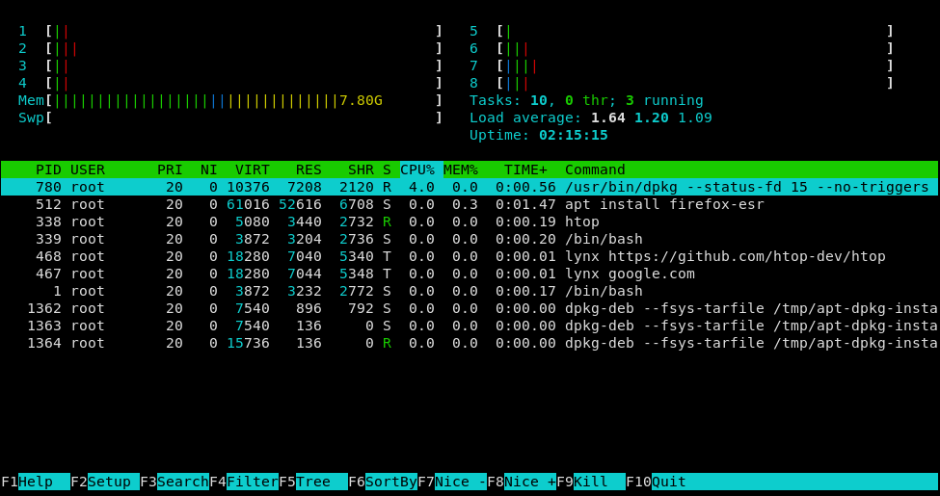
Real-World Example: Ubuntu VM on VirtualBox
Host View:
VirtualBox process uses 4GB RAM (allocated to VM).
Host OS sees this as a single application.
Guest View:
Ubuntu sees 4GB RAM + swap (managed by its kernel).
Runs htop as if on bare metal
Feature | Description | Example Use Case
Process Tree | Shows running processes hierarchically (parent/child). | Debugging zombie processes.
CPU/Memory Bars | Visualizes CPU cores (%), RAM (MB/GB), and swap usage. | Spotting resource hogs.
Mouse Interaction | Click to select, scroll, or kill processes (no CLI commands needed). | Easily killing frozen apps.
Customizable | Sort by CPU, RAM, or PID; change colors/columns. | Prioritizing RAM-heavy processes.
Search & Filter | Find processes by name (F3) or filter (F4). | Locating a specific Python script.
What is htop?
htop is an interactive, real-time process viewer and system monitor for Linux/Unix systems. It’s like the classic top command but with a user-friendly interface, colors, and mouse support.
https://github.com/htop-dev/htop

Slide 19
VM Setup Walkthrough (Part 1/2)

Slide 20
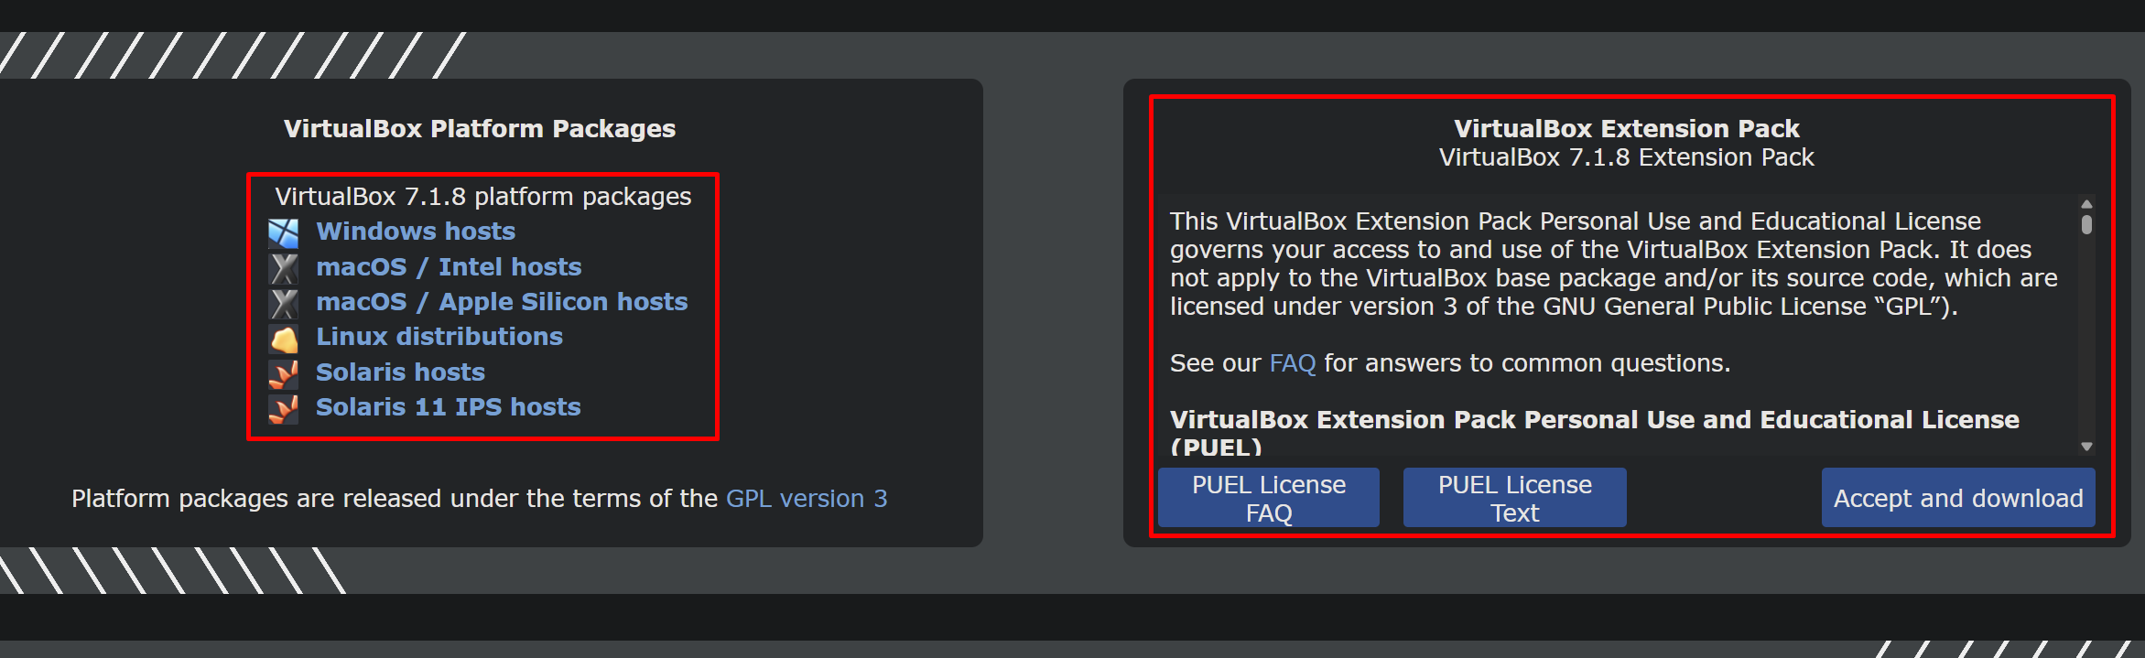
Oracle VirtualBox (Free, Cross-Platform)
Download:
Get the installer from VirtualBox’s official site. (https://www.virtualbox.org/)
Select the package for your host OS (Windows/macOS/Linux).
Install:
Windows: Run .exe and enable VT-x/AMD-V in installer (critical for performance).
Linux: Use package manager (sudo apt install virtualbox).

Slide 21
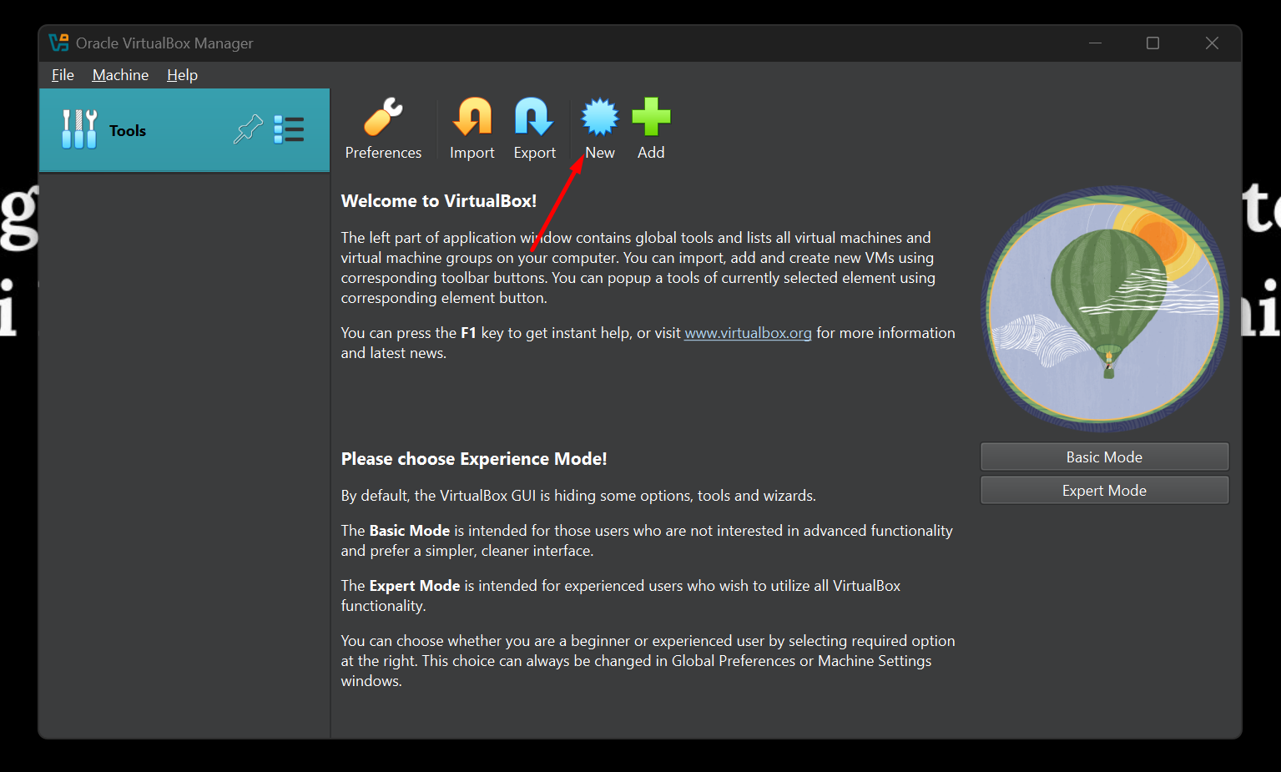
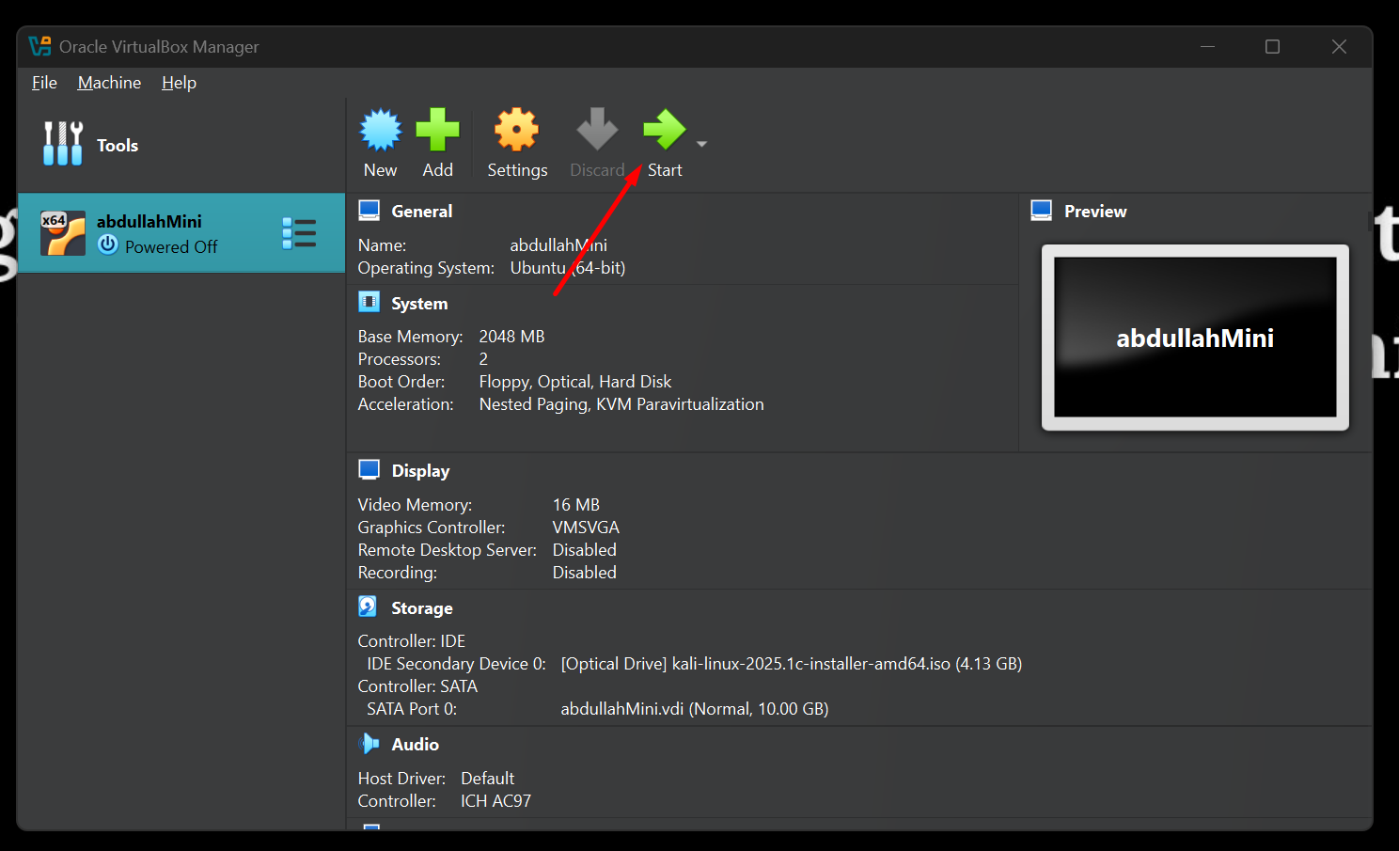
Create a New VM
1. Click "New" in VirtualBox Manager.
2. Configure VM:
Name: Ubuntu 22.04
Type: Linux
Version: Ubuntu (64-bit)
(Requires VT-x/AMD-V enabled in BIOS).
3. Allocate Resources:
RAM: 2GB (Don’t exceed 50% of host RAM to avoid swapping).
Virtual Disk: 20GB dynamically allocated (VDI format).
Technical Note:
VirtualBox creates a virtual disk image (VDI) that acts like a physical SSD to the VM.
The hypervisor uses copy-on-write to optimize space.

Slide 22
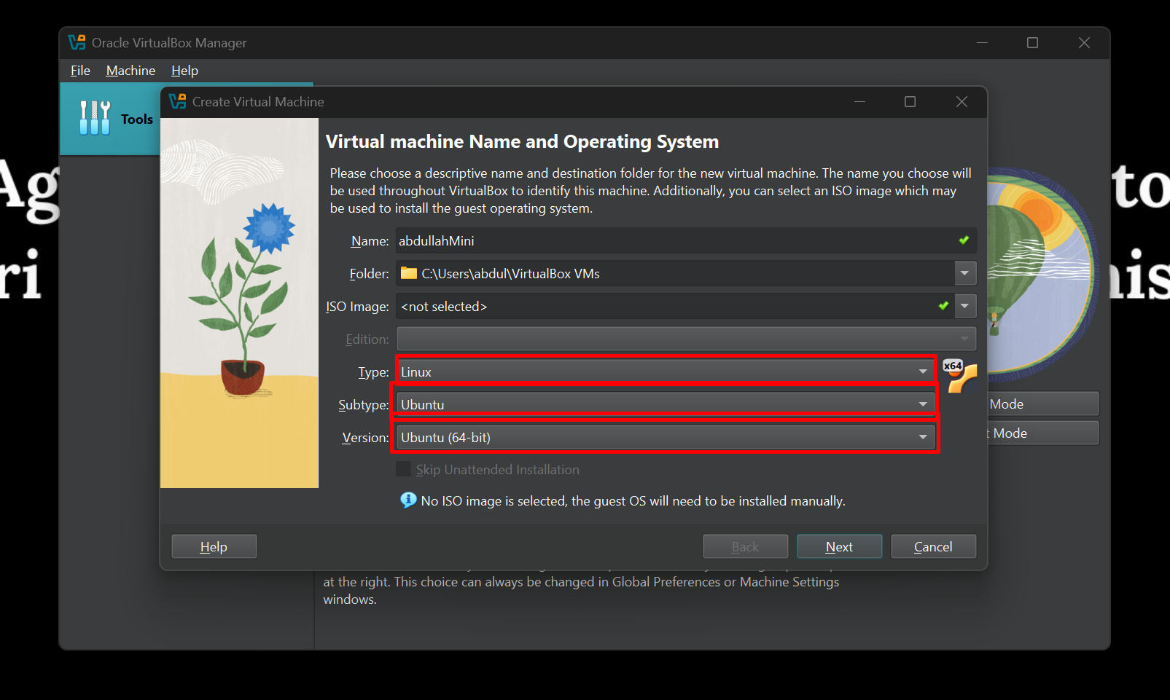
Create a New VM
1. Click "New" in VirtualBox Manager.
2. Configure VM:
Name: Ubuntu 22.04
Type: Linux
Version: Ubuntu (64-bit)
(Requires VT-x/AMD-V enabled in BIOS).
3. Allocate Resources:
RAM: 2GB (Don’t exceed 50% of host RAM to avoid swapping).
Virtual Disk: 20GB dynamically allocated (VDI format).
Technical Note:
VirtualBox creates a virtual disk image (VDI) that acts like a physical SSD to the VM.
The hypervisor uses copy-on-write to optimize space.

Slide 23
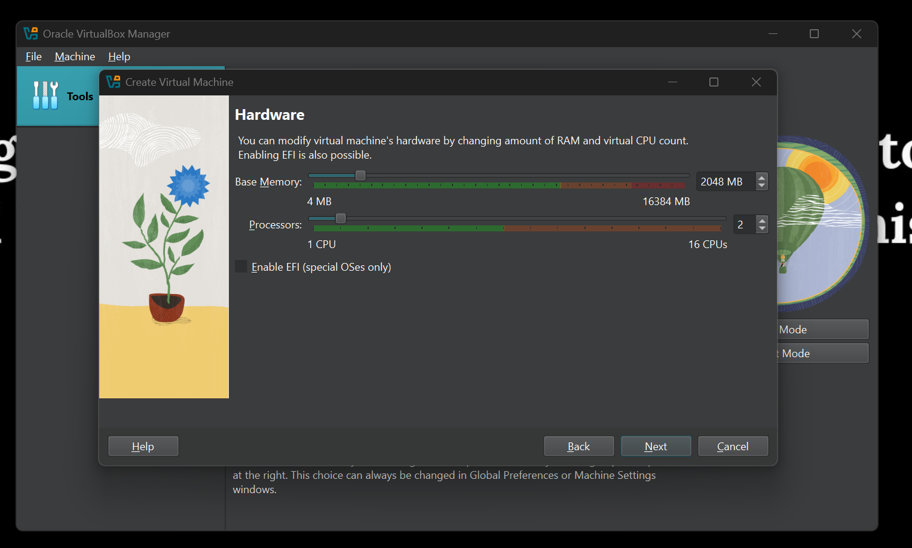
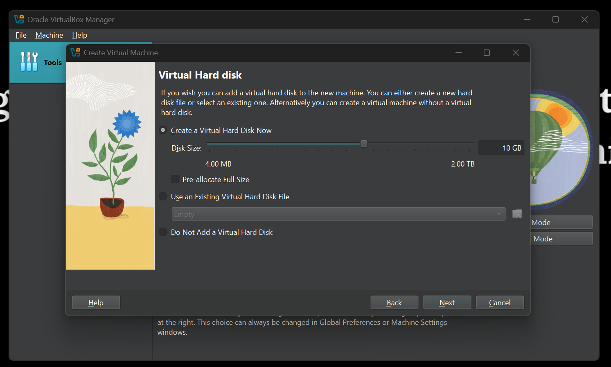
Create a New VM
1. Click "New" in VirtualBox Manager.
2. Configure VM:
Name: Ubuntu 22.04
Type: Linux
Version: Ubuntu (64-bit)
(Requires VT-x/AMD-V enabled in BIOS).
3. Allocate Resources:
RAM: 2GB (Don’t exceed 50% of host RAM to avoid swapping).
Virtual Disk: 20GB dynamically allocated (VDI format).
Technical Note:
VirtualBox creates a virtual disk image (VDI) that acts like a physical SSD to the VM.
The hypervisor uses copy-on-write to optimize space.

Slide 24
VM Setup Walkthrough (Part 2/2)

Slide 25
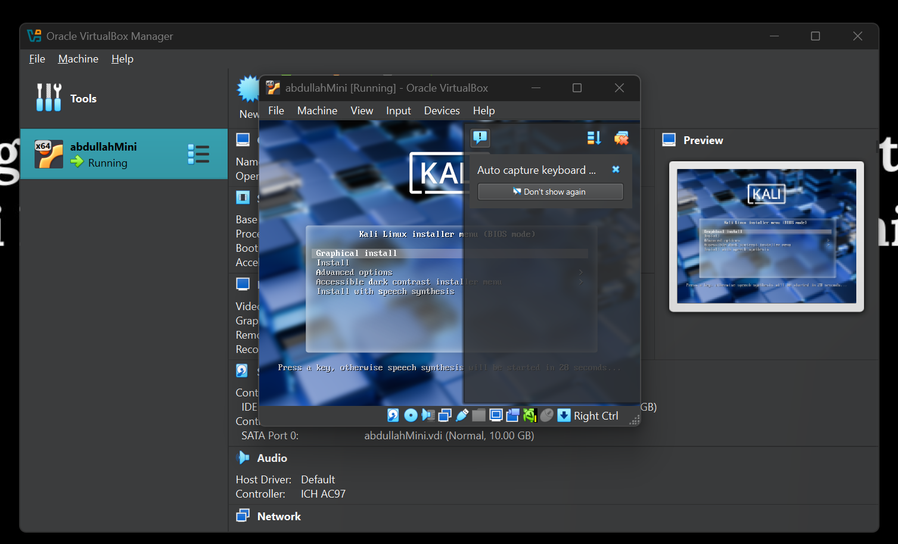
Install the OS
Attach ISO:
Select the VM → Settings → Storage → Optical Drive → Choose Ubuntu ISO.
Boot VM:
Start the VM → Follow Ubuntu installer prompts.
Partitioning: Use default ext4 + swap (handled by guest OS).
Low-Level Detail:
The hypervisor intercepts bootloader calls and redirects them to the virtual disk.
VirtualBox uses Nested Page Tables (NPT) for memory management if AMD-V/VT-x is enabled.

Slide 26
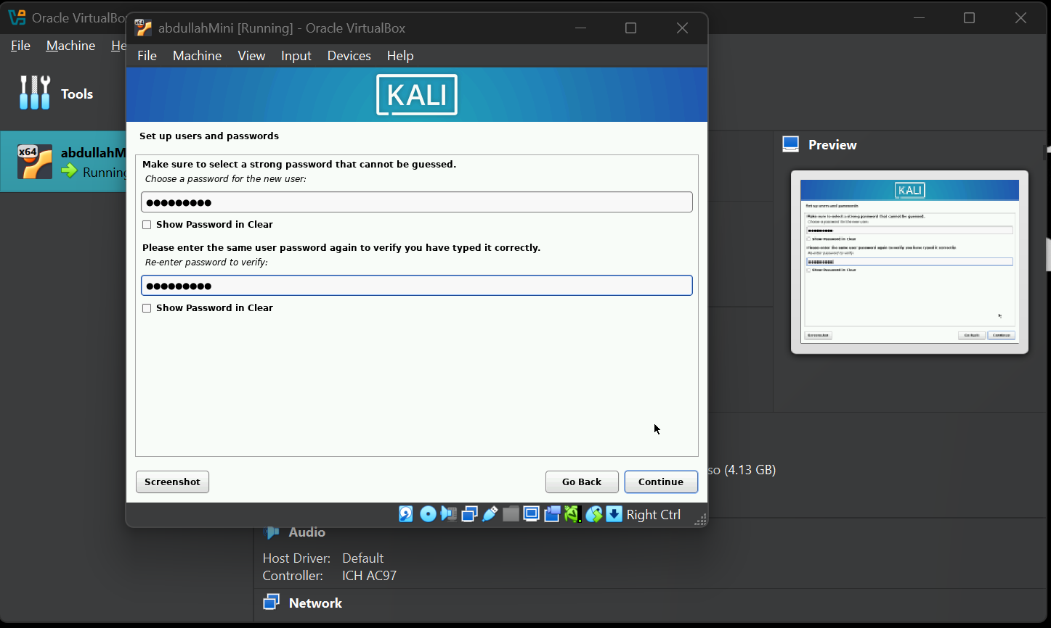
Configure VM
Network:
NAT (Default): VM shares host’s IP (safe for most uses).
Bridged: VM gets its own LAN IP (for servers).
Shared Folders:
Settings → Shared Folders → Add host folder (accessible in VM via
Technical Note:
NAT uses the host’s network stack, while Bridged requires a dedicated IP.
Shared folders rely on VirtualBox Guest Additions (kernel modules for performance).

Slide 27
Little Brief of VMs Deadlock
Type | Description | Example
Direct Deadlock | Two VMs block each other’s resources directly. | VM1 waits for VM2’s RAM, VM2 waits for VM1’s CPU.
Indirect Deadlock | Circular chain of VMs blocking resources. | VM1 → VM2 → VM3 → VM1 (all waiting).
A deadlock occurs when two or more VMs block each other indefinitely by holding resources needed by another, creating a cyclic dependency.
Example Scenario:
VM1 holds CPU and waits for RAM from VM2.
VM2 holds RAM and waits for CPU from VM1.
Result: Both VMs freeze, requiring manual intervention.
Why Deadlocks Happen in Virtualization
Resource Contention:
Overcommitted CPU/RAM/disk I/O during live migration or consolidation.
Improper Scheduling:
Hypervisor fails to detect circular dependencies in resource allocation.
Storage Locks:
Multiple VMs accessing the same virtual disk (clustered databases).
Real-World Context: VM Migration Deadlocks
During server consolidation, hypervisors (VMware vMotion, Xen) may deadlock if:
Simultaneous Migrations: VMs swap places on hosts with insufficient resources.
Improper Order: Migrating VM-A to Host-2 while VM-B moves to Host-1 at the same time.

Slide 28
Security in Virtual Machines: Challenges
Key Security Challenges
Threat | Description | Example
VM Isolation Failures | Flaws allowing VMs to access others’ resources. | CVE-2021-1782 (Apple Hypervisor).
Hypervisor Attacks | Exploits like VM escape (breaking out of VM). | CVE-2018-3646 (L1TF Spectre variant).
Side-Channel Attacks | Cross-VM leaks via CPU caches (Spectre). | AWS Crosstalk (2020).
Why It Matters:
A single compromised VM can jeopardize the entire host.
Cloud providers (AWS, Azure) rely on strong VM isolation.

Slide 29
Core Challenges Explained
VM Isolation Failures
Problem: Like faulty apartment walls letting neighbors spy on you.
Real Example: CVE-2021-1782 (Apple Hypervisor bug) allowed VMs to peek into others' memory.
Hypervisor Attacks (VM Escape)
Problem: Like a prisoner breaking out of jail to control the prison.
Real Example: CVE-2018-3646 (Spectre variant) let attackers steal data from other VMs.
Virtual Machine Introspection (VMI)
How It Works:
The hypervisor acts like a security camera outside the VM.
Scans memory for malware without the VM knowing.
Example:
Detects ransomware encrypting files by spotting unusual memory patterns.

Slide 30
VM Use Cases: Hacking, Testing & Learning Linux
1. "Break Stuff Safely" – Isolated Playground
Why VMs?
Test malware, exploits, or risky configs without harming your main OS
Example: Analyzing ransomware in a VM → Delete VM after research
Use VirtualBox 'Host-Only' networking to study malware traffic without internet exposure.
2. HackTheBox & CTF Training
Safe Practice Environment:
Run vulnerable machines (e.g., HTB "Jerry") in a VM
Avoids: Accidentally attacking real networks
# Kali Linux VM pre-loaded with tools for:
- nmap scans
- Metasploit exploits
Password cracking
3. "Pause, Reset, Clone" – Gaming Analogy
Like Video Game Saves:
Snapshot: Save VM state before testing a hack
Reset: Revert to clean state after infection
Clone: Duplicate a configured VM for team sharing

Slide 31
VMs vs Containers in Server Environments
Negative Side of Virtual Machines (in Server Use) & How Docker Containers Solve These Problems

Slide 32
Negative Side of Virtual Machines (in Server Use)
Limitation | Explanation
Heavy Resource Use | Each VM runs a full OS + virtualized hardware → high RAM, CPU, and storage needs.
Slow Boot Times | Full OS initialization causes delays—can take several minutes to start.
Disk Space Waste | VMs replicate entire environments, increasing image sizes (often 10+ GB).
Inefficient Scaling | Spinning up new VMs for microservices or updates is slow and hardware-heavy.
OS Overhead | Every VM includes unnecessary services from the OS, even if not used by the app.

Slide 33
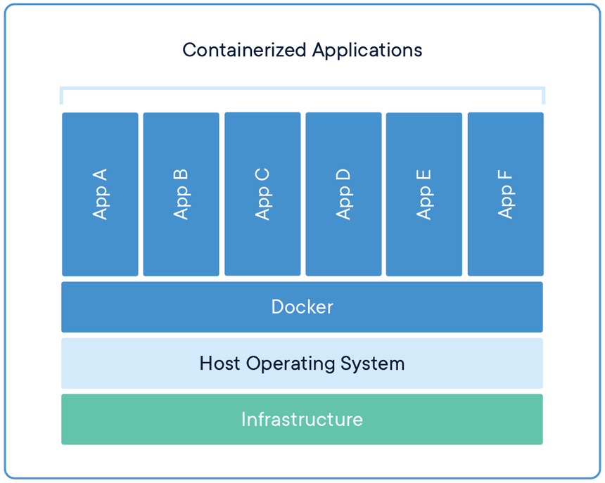
How Docker Containers Solve These Problems
Docker Container Advantage | How It Solves the VM Problem
Lightweight | Only contains app + dependencies, no full OS.
Faster Startup | Boot in milliseconds, ideal for microservices & CI/CD.
Smaller Size | Container images are often < 1 GB vs 10+ GB for VMs.
Portability | Easily move across environments with docker pull/push.
Shared Kernel | Reduces overhead by using host OS kernel → more efficient resource use.
While VMs were revolutionary for resource optimization, they come with overhead—each one runs its own OS. That means more RAM, more disk, and slower boot times. Enter Docker. Containers solve these problems by being faster, lighter, and ideal for agile deployment models. Think milliseconds vs minutes. And while VMs are still essential for full isolation or different OSes, containers let us scale modern apps rapidly.

Slide 34
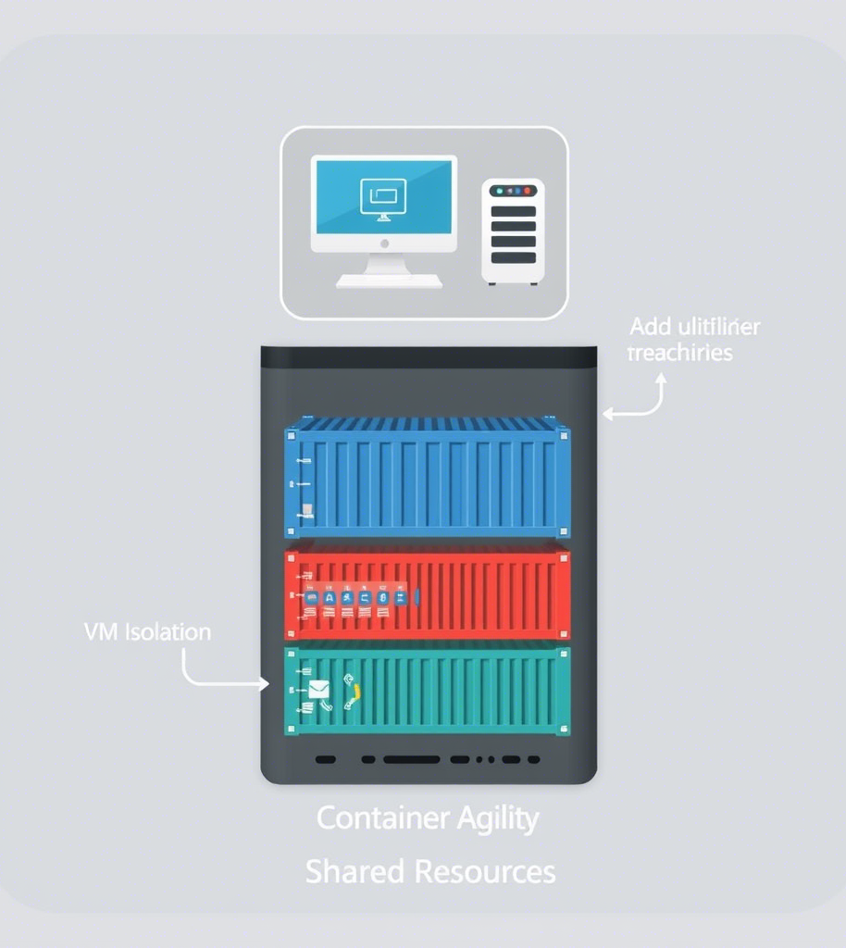
VMs + Containers – Best of Both Worlds
Modern Cloud Architecture Why We Still Need VMs 1. Security Isolation
Example: AWS runs containers inside EC2 VMs
Prevents container breakout from compromising neighbors
Hybrid Approach
Cloud Host
[VM for Tenant A] → Runs Docker/K8s
[VM for Tenant B] → Runs Docker/K8s
VMs → Hardware-level security
Containers → Rapid scaling within VMs

Slide 35
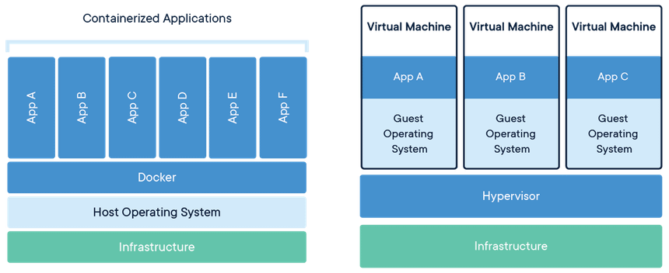
Why This Matters with Real-World Use Case Example
Cost Savings: 10x more containers than VMs per server
Security: Defense in depth (VMs + containers)
Flexibility: Legacy apps in VMs, modern apps in containers
Netflix or Uber:
They run Docker containers inside VMs on the cloud
This setup gives:
VM-level isolation between customers or tenants
Container-level speed and scaling for microservices

Slide 36
What is Docker Container Little Brief
A Docker container is a standardized, encapsulated environment that runs applications. It includes all the necessary components such as code, dependencies, libraries, and configuration files needed for the application to run. Containers are isolated from one another and from the underlying infrastructure, allowing them to run efficiently in different environments in isolation.
Containers are created from Docker images, which are read-only templates that contain instructions for creating a container. Once a container is created, it has an additional read-write layer on top of the read-only layers from the image, making it mutable and allowing changes at runtime as required.
Docker containers can communicate with each other through well-defined channels and use fewer resources than virtual machines because they share the services of a single operating system kernel.
To manage Docker containers, users can use commands such as docker ps -a to list all containers, docker rename [container] [new_name] to rename a container, docker start [container] to run a container, docker stop [container] to stop a container, and docker wait [container] to make a container wait until other running containers stop.
For deploying and scaling a set of containers across different machines or virtual machines, a container orchestration platform like Kubernetes is often used.
“A Docker container is a lightweight, standalone, executable package of software that includes everything needed to run an application (code, dependencies, configs) in isolated user-space instances on a shared OS kernel.”
https://www.docker.com/resources/what-container/

Slide 37
Virtual Machines (VMs) – The Ultimate Cheat Sheet
Aspect | Key Points
What? | Software emulation of a physical computer (runs OS inside OS).
Why? | 1. Isolated testing/sandboxing 2. Run multiple OSes on one hardware 3. Cloud computing backbone
Types | *Type 1 (Bare-metal): VMware ESXi, Hyper-V, KVM *Type 2 (Hosted): VirtualBox, VMware Workstation
Pros | ✔ Strong isolation ✔ Cross-OS compatibility ✔ Snapshot/rollback support
Cons | ✖ High overhead ✖ Slow boot times ✖ Resource-heavy
Vs Containers | VMs virtualize hardware; containers virtualize OS (lightweight but less isolated).
Top Use Cases | • Malware analysis • Cloud servers (AWS EC2) • Legacy app support
Future | Hybrid models (VMs + containers) for security + agility (e.g., AWS Nitro).
Hardware → Hypervisor → VMs → Guest OS + Apps
VMs = Gold standard for isolation. Containers win for speed, but VMs rule where security matters.

Slide 38
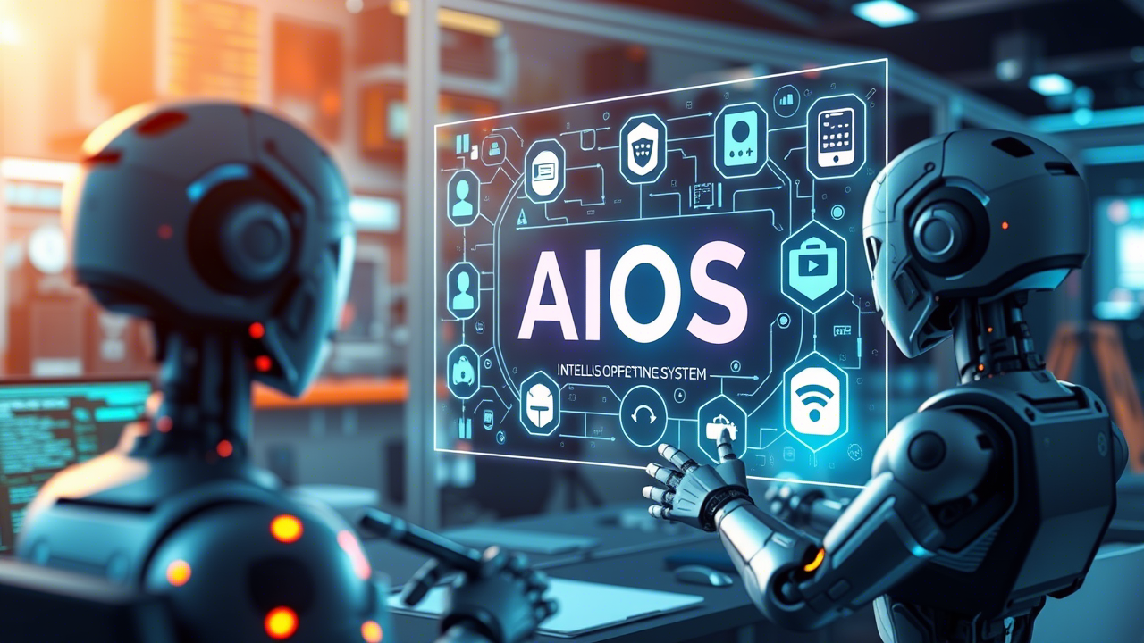

Slide 39
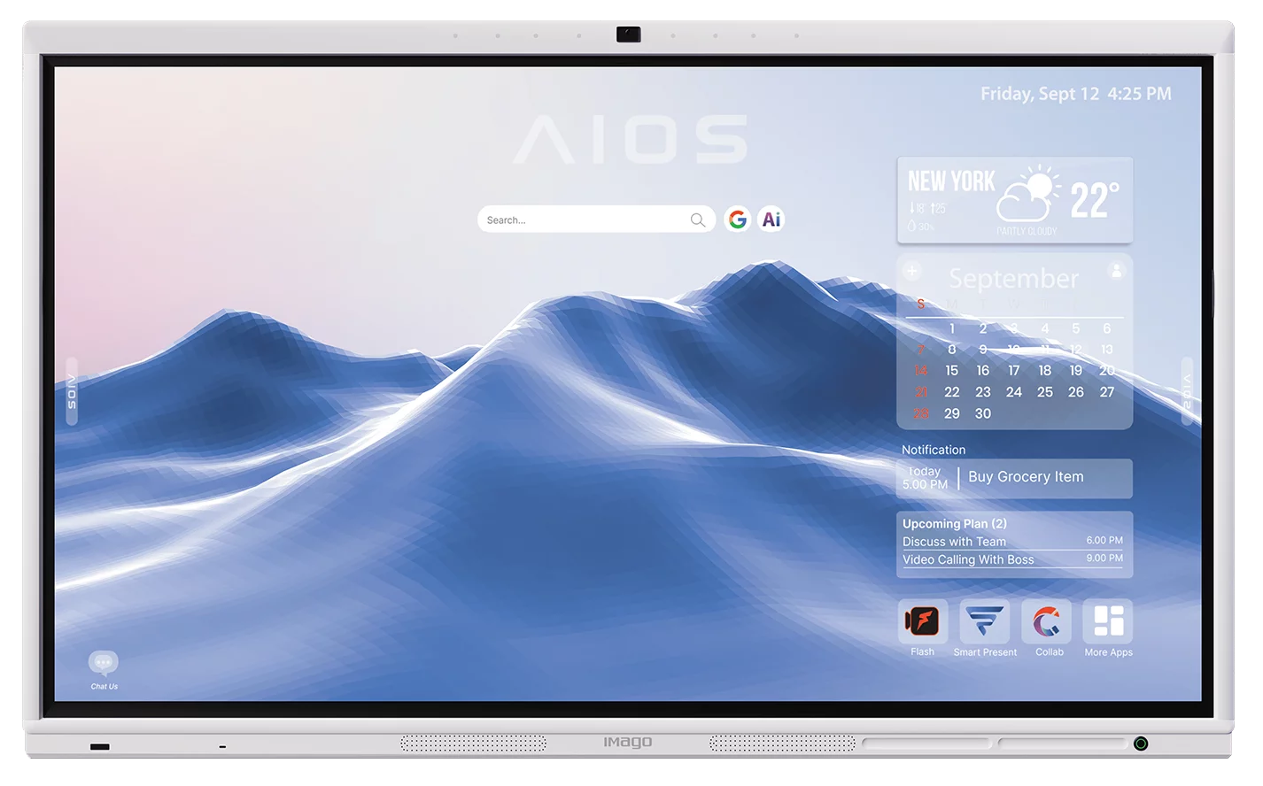
LLM as OS, Agents as Apps: Envisioning AIOS, Agents and the AIOS-Agent Ecosystem

Slide 40
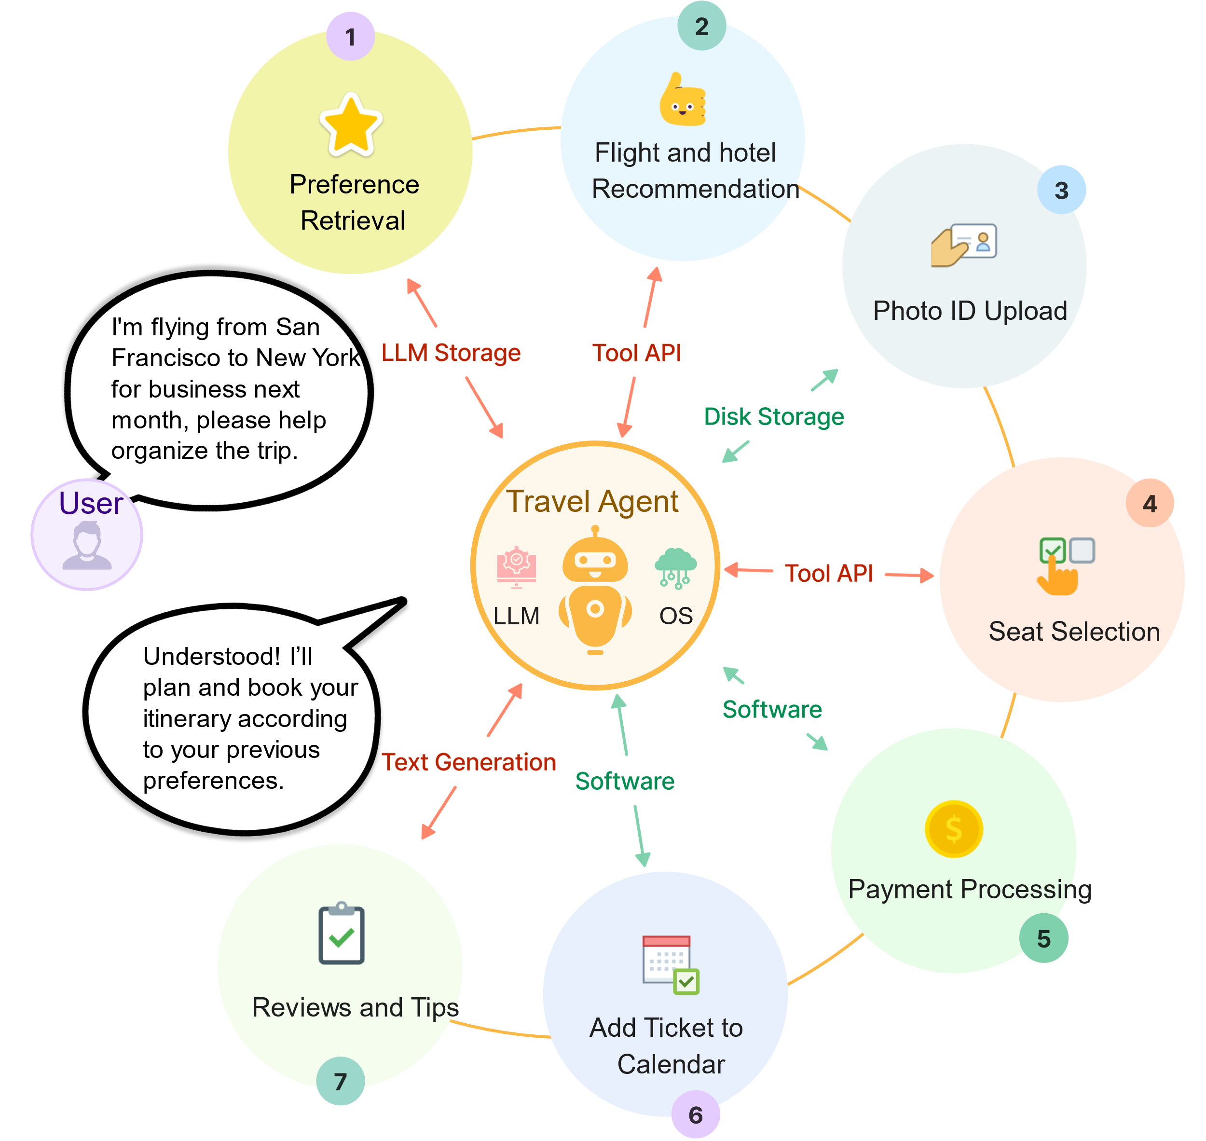
Introduction to AIOS
AIOS (Artificial Intelligent Operating System) is an operating system that leverages Large Language Models (LLMs) to manage resources and provide intelligent services.
Visions: AIOS aims to create an ecosystem where LLMs serve as the core, enabling AI Agent Applications (AAPs).
Democratizes software development by allowing natural language programming, enhancing accessibility.
Reference: Ge et al., "LLM as OS, Agents as Apps: Envisioning AIOS, Agents and the AIOS-Agent Ecosystem" (Page 1-2).

Slide 41
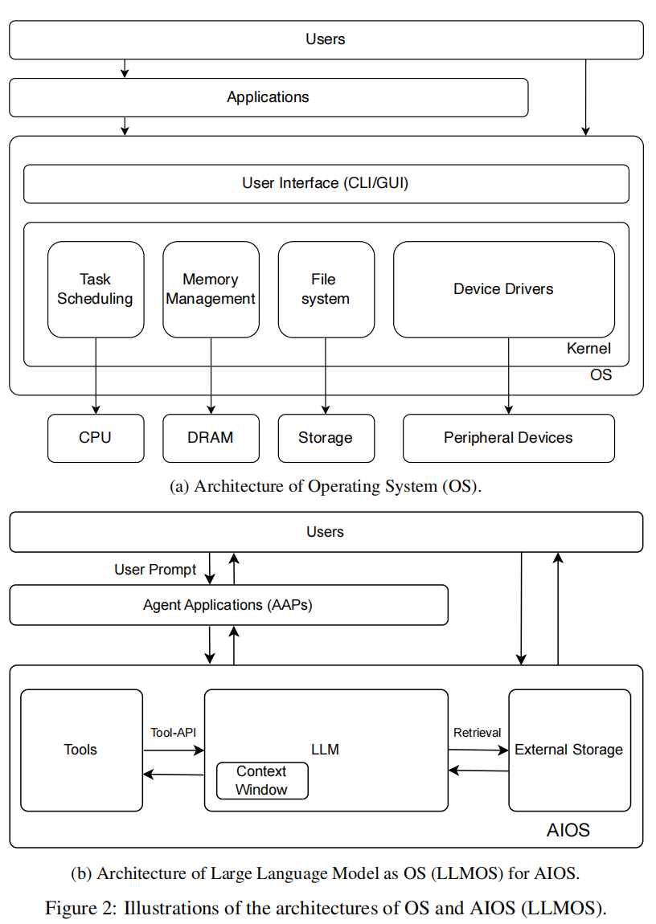
Traditional OS vs. AIOS
Traditional OS:
Manages hardware (CPU, memory, storage).
Apps developed using programming languages by skilled developers.
Interaction via command-line/GUI.
AIOS:
Manages intelligent resources (LLMs, tools) and hardware.
Apps (AAPs) developed using natural language, accessible to non-experts.
Interaction via natural language prompts.
Reference: Ge et al., "LLM as OS, Agents as Apps: Envisioning AIOS, Agents and the AIOS-Agent Ecosystem" (Page 4-6).

Slide 42
Key Components of AIOS
1. LLM as Kernel
What? The LLM (ChatGPT) is the "brain" of the system, managing tasks like reasoning and planning.
Real-world analogy: Like your phone’s OS kernel (Android/iOS), but for AI tasks.
Example: When you ask "Plan a 3-day Tokyo trip", the LLM-kernel decomposes this into flights, hotels, and activities.
2. Context Window as Memory
What? The LLM’s "working memory" (like RAM) that holds recent conversations/data.
Limitation: Just as your phone slows down with too many apps open, LLMs forget earlier chats if the context window overflows.
Example: ChatGPT-4 Turbo’s ~128K token limit = ~300 pages of text.
3. External Storage as File System
What? Long-term memory for LLMs (databases, vector stores).
Real-world analogy: Like cloud storage (Google Drive) for your AI.
Example: A customer support AI retrieves product manuals from its "file system" to answer questions.
4. Tools as Devices/Libraries
What? Plugins/extensions that give LLMs superpowers (APIs, robots, etc.).
Real-world analogy: Like plugging a printer or GPS into your computer.
Example: An AI uses Google Search API for real-time data or Robotic Arm API to sort packages.
5. User Prompts as UI
What? Natural language commands replace traditional coding.
Real-world analogy: Talking to Siri, but for complex tasks like building apps.
Example: "Create a website that sells sneakers" → AIOS generates the code and design.

Slide 43
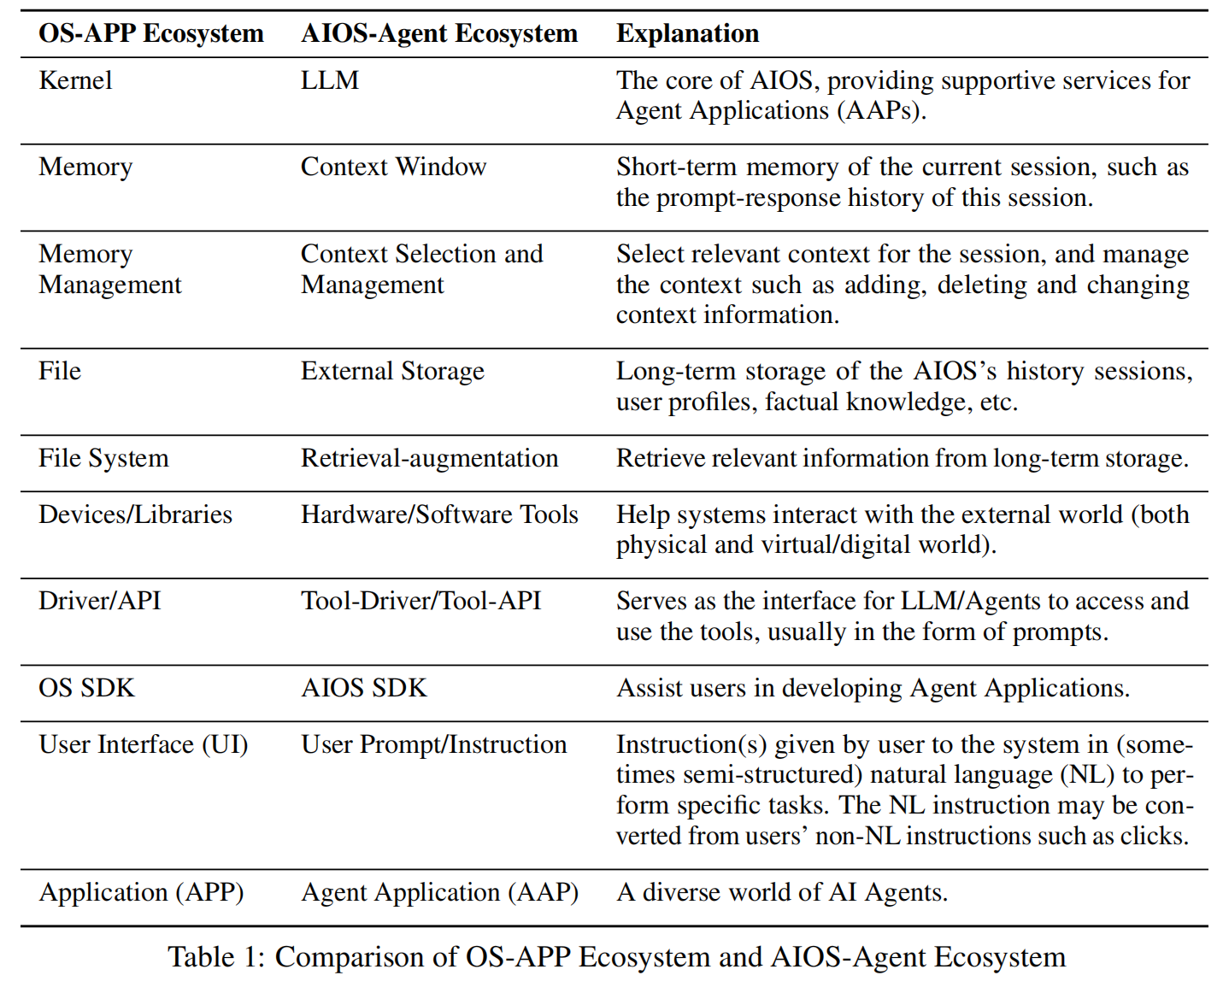
Architecture of AIOS
In this section, we establish the conceptual framework of “LLM as OS (LLMOS),” creating parallels
between LLMOS components and traditional OS elements, as is shown in Table 1. In this analogy,
the LLM is compared to the OS kernel, the context window to memory, and external storage to the file
system. Tools and user prompts are equated with devices/libraries and the user interface, respectively.
We will delve into the specifics of this correlation in the following discussion.

Slide 44
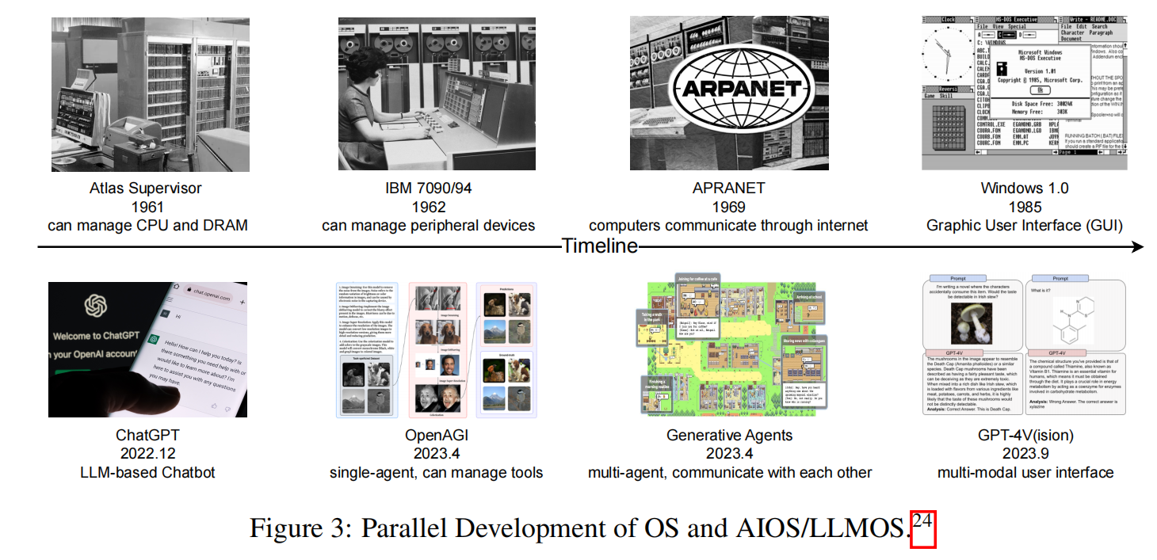
Development of OS and AIOS Aligned
The comparison in Figure 3 illustrates the parallel evolution of Operating Systems (OS) and LLM as OS (LLMOS), emphasizing their advancements in functionality and user interaction. Here’s a concise summary:
Early Operating Systems:
Atlas Supervisor: Managed basic computer resources like CPU and DRAM.
UNIX: Evolved to handle various peripheral devices, showcasing increased sophistication.
Progression of LLMs:
Transitioned from simple text-in-text-out chatbots to complex LLM-based agents capable of managing diverse tools for intricate task solving, exemplified by OpenAGI.
Role of ARPANET:
Highlighted as crucial in developing TCP/IP protocols, which established the foundation for the modern Internet, enabling communication between multiple computers.
Interconnected Systems:
The advancement of LLM-based multi-agent systems reflects a trend towards more interconnected and collaborative computing environments, similar to the evolution seen in traditional operating systems.

Slide 45
AIOS-Agent Ecosystem
The AIOS-Agent Ecosystem is a new paradigm where Large Language Models (LLMs) serve as the operating system (AIOS), and AI Agents act as applications (AAPs) built on top of it. This ecosystem enables intelligent, autonomous, and collaborative task-solving.
Agents as Applications (AAPs)
Specialized AI agents designed for specific tasks (trip planning, medical consulting, financial management).
Each AAP includes:
Agent Profile (role, capabilities, personality).
External Knowledge & Tools (APIs, databases, hardware interfaces).
Example: A travel agent AAP can autonomously book flights, suggest itineraries, and adjust plans based on user preferences.
Single and Multi-Agent Systems
Single Agent: Operates independently (a coding assistant, personal tutor).
Multi-Agent: Agents collaborate or compete (a debate system, software development team of AI agents).
Collaborative: Agents share knowledge (MetaGPT for automated software development).
Adversarial: Agents debate or negotiate (MAD framework for refining decisions).
Human-Agent Interaction
Frameworks like AutoGen allow customizable, conversable agents that blend LLMs, human input, and tools.
Users interact via natural language, eliminating the need for programming expertise.

Slide 46
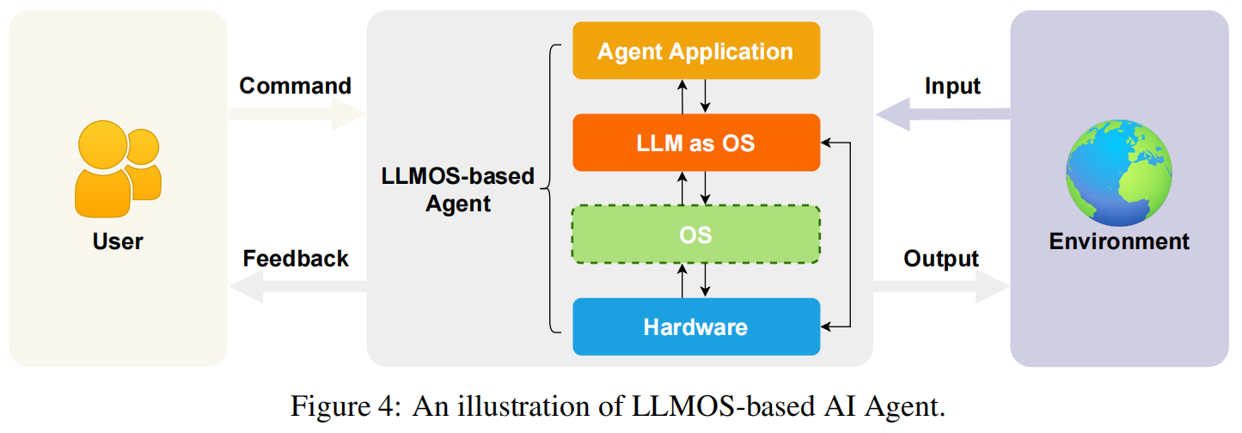
Applications of AIOS and AI Agents
Single-Agent Applications
Autonomous task solvers (Corex for reasoning, WarAgent for historical simulations).
Use cases: Coding assistants, personalized tutors, robotic control.
Multi-Agent Systems
Collaborative agents (MetaGPT for software dev, ChatEval for debate).
Use cases: Simulated economies, disaster response planning.
Human-Agent Interaction
Frameworks like AutoGen for customizable, conversational agents.
Use cases: Customer support, creative brainstorming.

Slide 47
Challenges in AIOS Development
Memory Limits
Context window constraints → retrieval-augmented LLMs.
Tool Fragmentation
Standardizing APIs (ToolLLM).
Security Risks
Adversarial prompts → detection mechanisms.
Natural Language Ambiguity
DSLs for precise agent instructions.

Slide 48
Advanced Features of AIOS
Multi-Modal Capabilities
Integrates text, images, audio (GPT-4V)
Example: Agent analyzes medical scans (image) + patient history (text) → diagnosis
Self-Adaptation
Agents learn from feedback (Reflexion framework)
Dynamic tool selection based on task complexity

Slide 49
Real-World Applications
Sector | Example | Benefit
Healthcare | AI diagnostic assistant | 24/7 patient monitoring
Education | Personalized math tutor | Adapts to learning styles
Automation | Factory robot coordinator | Real-time process optimization

Slide 50
Conclusion
Example:
Old way: You manually set phone alarms for meetings.
AIOS way: Your OS analyzes emails/calendar → automatically sets reminders + books transport.
Paradigm Shift
LLMs as OS kernels enable "operating systems with soul."
Democratization
Natural language programming → no-code AI development.
Future Work
Focus on security, scalability, and human-AI symbiosis.
Today, building apps requires coding. With AIOS:
Anyone can "program" by just talking
Malicious "jailbreak" prompts
System crashes during peak usage
When should AI override humans?

Slide 51
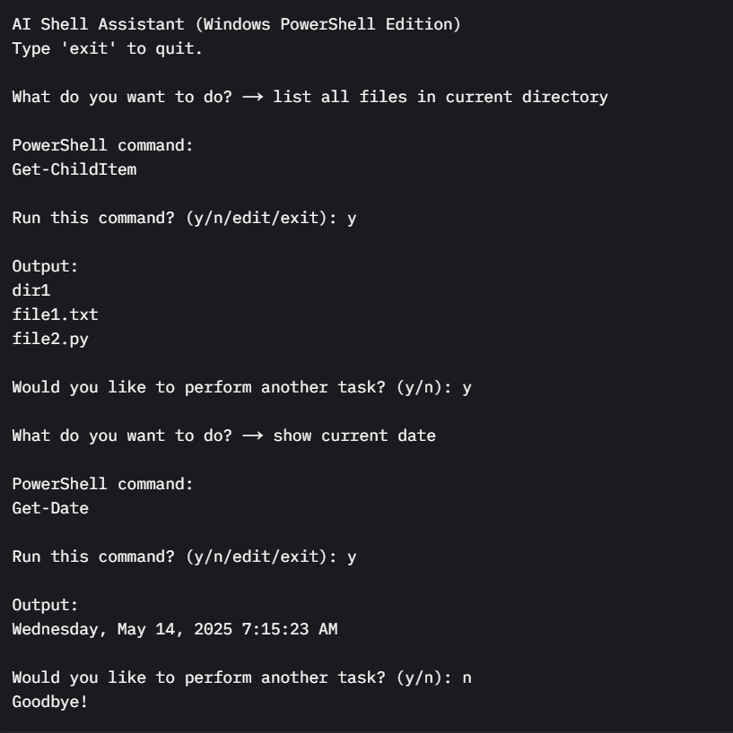
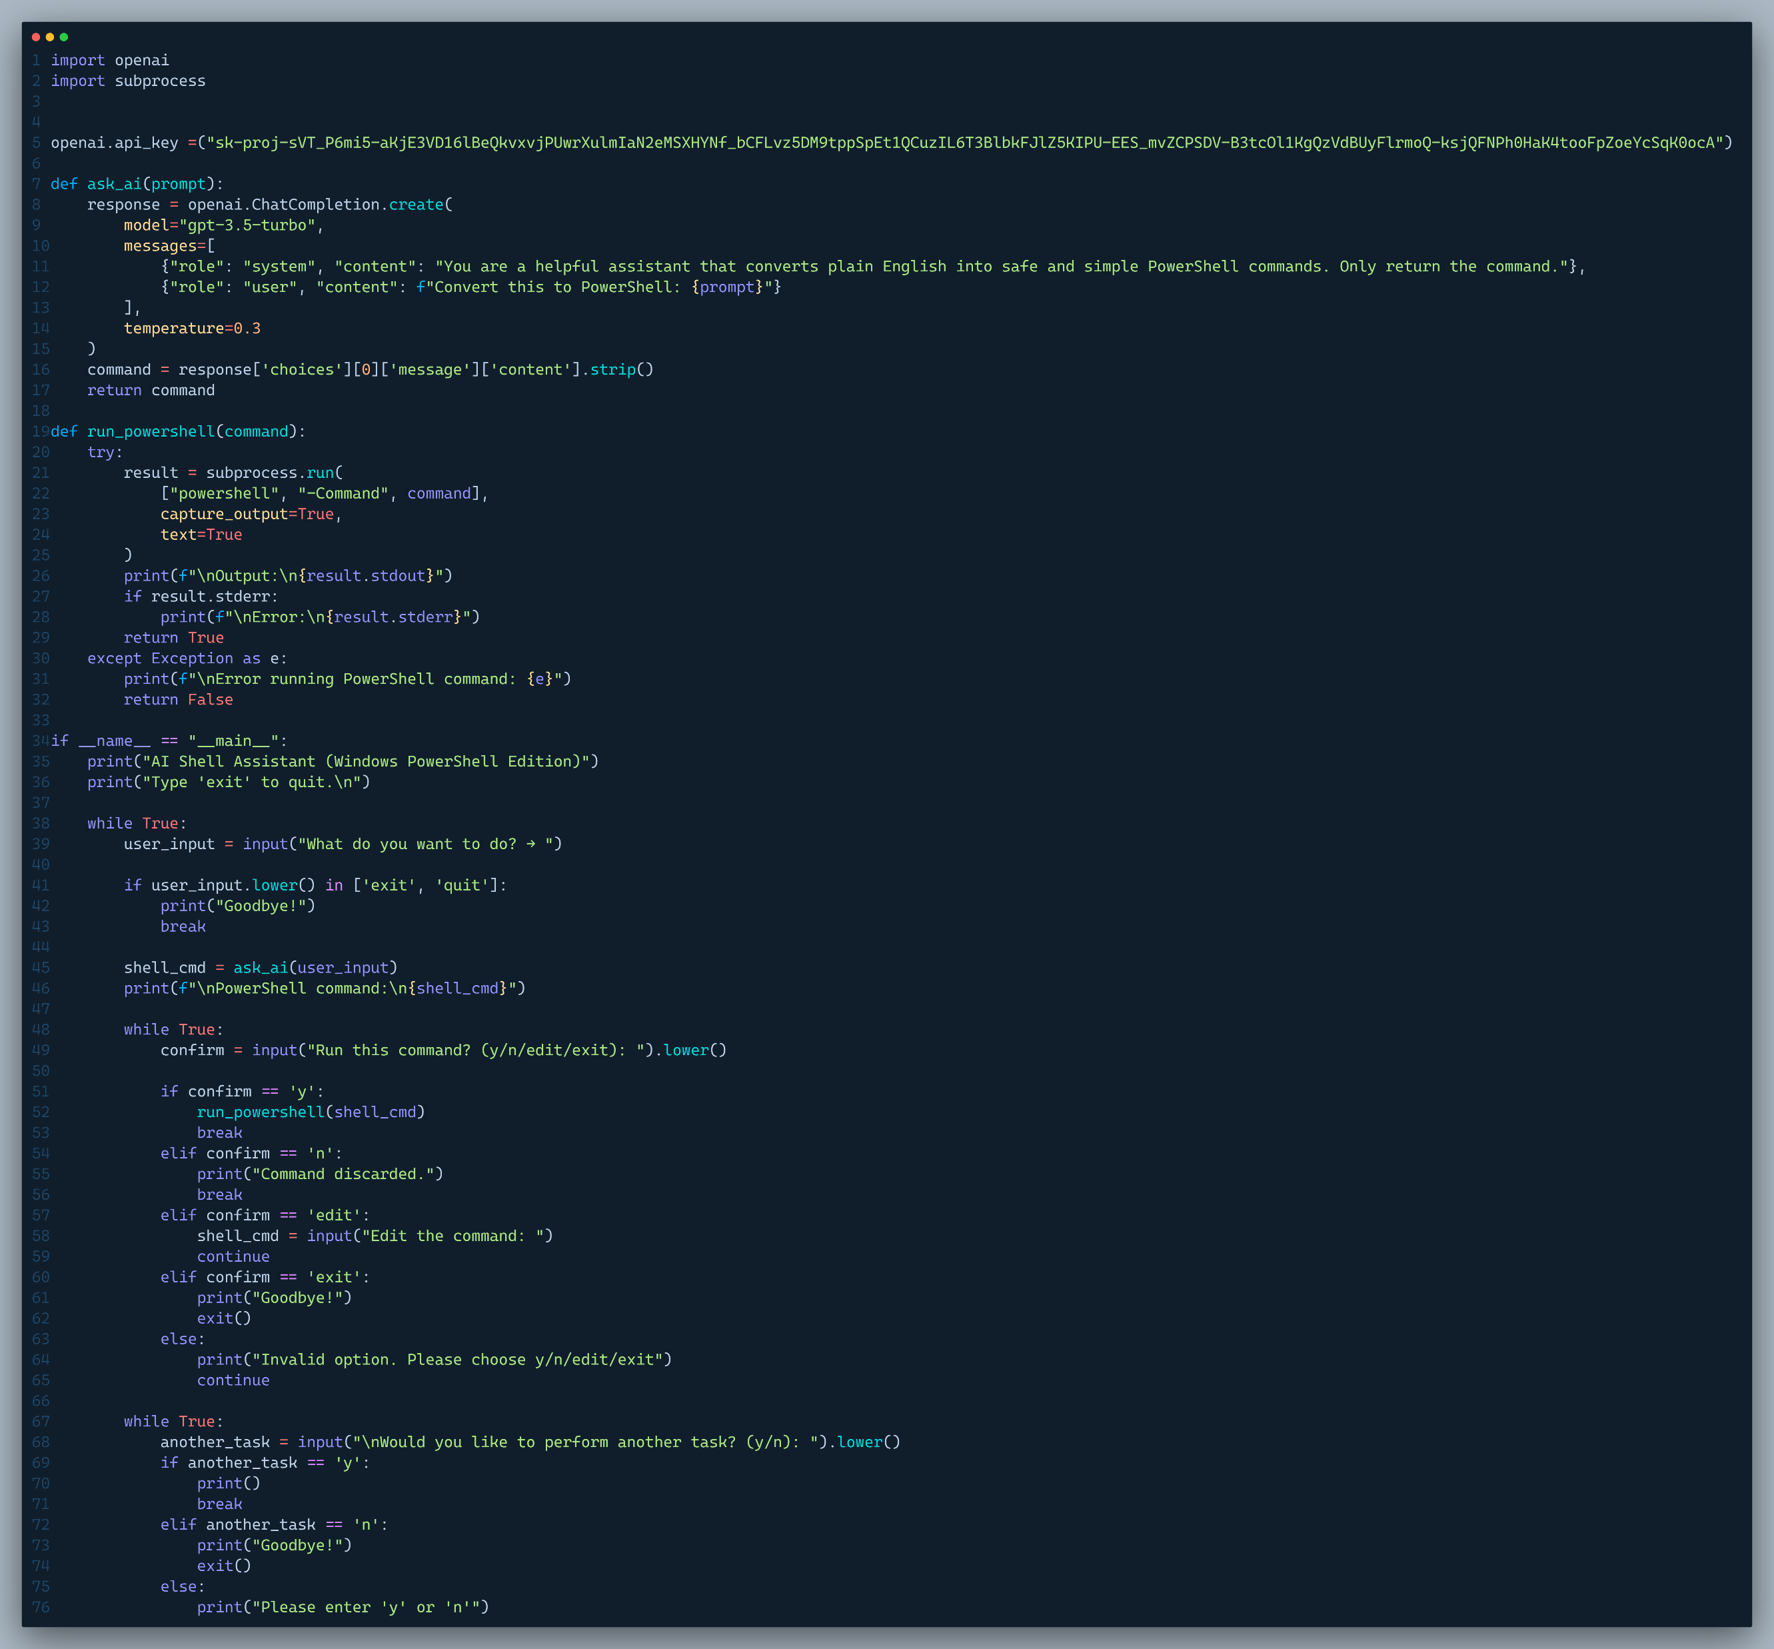
Little Implementation Of AIOS

Slide 52
Challenges & Open Questions
Technical Energy efficiency (1 LLM query ≈ 100 Google searches) Real-time constraints (e.g., stock trading agents)
Ethical Bias mitigation in agent decisions Explainability of multi-agent workflows
Open Questions Should critical systems (healthcare) allow full agent autonomy?
Example: AIOS agents in smartphones → battery drains 10x faster.
Bias in Decisions: The "Unfair Hiring Manager" Problem
Amazon scrapped an AI recruiting tool in 2018 for doing exactly this.

Slide 53

We are looking for Questions

Slide 54

If you have any question ...please keep it for yourself .. We are not GPT

Slide 55
Thank you

